Slide 1

2-Folded Architecture for IIR Filter
Y[n] = a*Y[n-3] + b*Y[n-5] + X[n]
Name: Pawan Kumar
Roll No.: 214102412
Under Guidance of
Prof. Shaik Rafi Ahamad
EEE Dept. IIT Guwahati
EE516: VLSI DSP
13th May, 2022

Slide 2
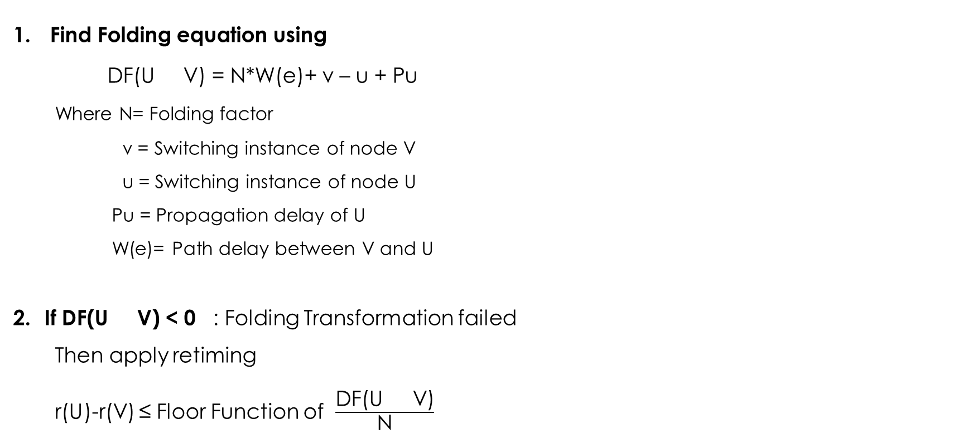
Basic Steps for Folding Transformation:
Find Folding equation using
DF(U V) = N*W(e)+ v – u + Pu
Where N= Folding factor
v = Switching instance of node V
u = Switching instance of node U
Pu = Propagation delay of U
W(e)= Path delay between V and U
If DF(U V) < 0 : Folding Transformation failed
Then apply retiming
r(U)-r(V) ≤ Floor Function of $\frac{\text{D}\text{F}\text{(}\text{U} \text{V}\text{)}}{\text{N}}$

Slide 3
3. Find Constrain graph
r(i) - r(j) ≤ k ; means edge from node j to node i with K delay
And extra edges are from extra node(n+1) to each node with 0 delay, n is total no. of nodes
4. Find Retiming Values
r(i) = Shortest path from extra node (n+1) to i-th node
5. Find new Delays for edges
Wr(e)= W(e)+ r(V ) - r(U)
6. Calculate new folding equation
DF’(U V) = N*Wr(e)+ v – u + Pu

Slide 4
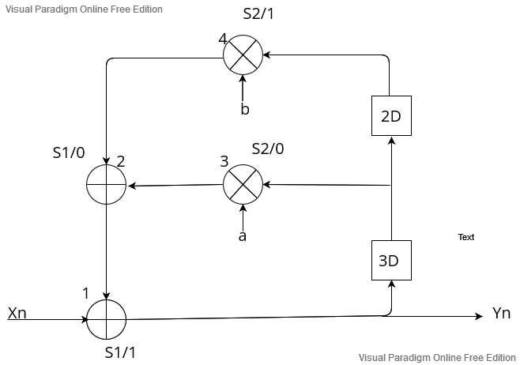
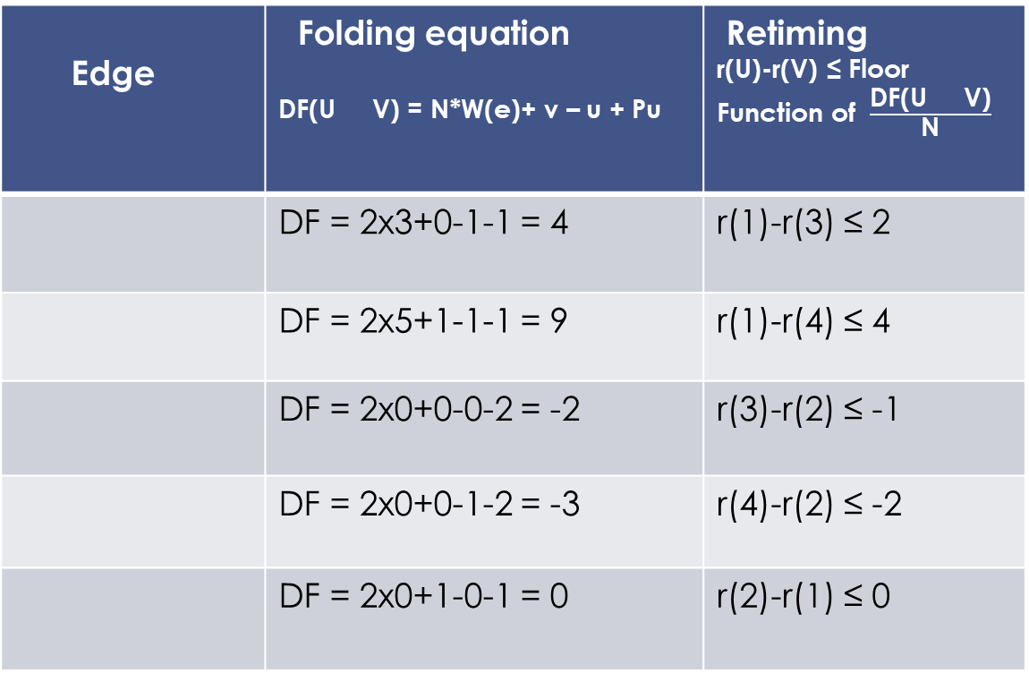
Block diagram of given equation: Y[n] = a*Y[n-3] + b*Y[n-5] + X[n]
Edge | Folding equation DF(U V) = N*W(e)+ v – u + Pu | Retiming r(U)-r(V) ≤ Floor Function of $\frac{\text{D}\text{F}\text{(}\text{U} \text{V}\text{)}}{\text{N}}$
 | DF = 2x3+0-1-1 = 4 | r(1)-r(3) ≤ 2
 | DF = 2x5+1-1-1 = 9 | r(1)-r(4) ≤ 4
 | DF = 2x0+0-0-2 = -2 | r(3)-r(2) ≤ -1
 | DF = 2x0+0-1-2 = -3 | r(4)-r(2) ≤ -2
 | DF = 2x0+1-0-1 = 0 | r(2)-r(1) ≤ 0
1
3D
3
5D
1
4
0D
3
2
0D
4
2
0D
2
1

Slide 5
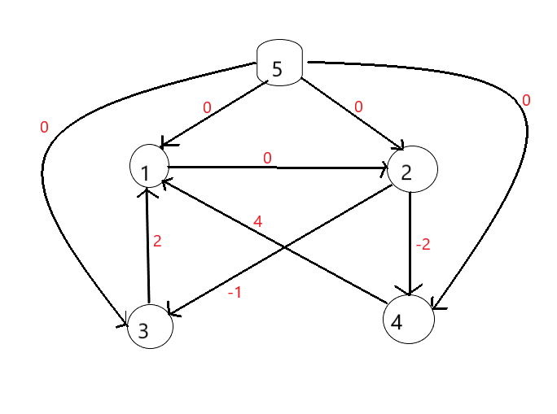
r(i) = Shortest path from extra node (n+1) to i-th node
r(1) = 0 ; 5 to 1
r(2) = 0 ; 5 to 2
r(3) = -1 ; 5 to 2 & 2 to 3
r(4) = -2 ; 5 to 2 & 2 to 4
Constrain Graph:
Edge | New path delay Wr(e)= W(e)+ r(V ) - r(U)
 | Wr(e)= 3+ (-1) – 0=2
 | Wr(e)= 5+ (-2) – 0=3
 | Wr(e)= 0+ 0 – (-1)=1
 | Wr(e)= 0+ 0 – (-2)=2
 | Wr(e)= 0+ 0 – 0=0
3D
1
3
5D
1
4
0D
3
2
0D
4
2
0D
2
1
2

Slide 6
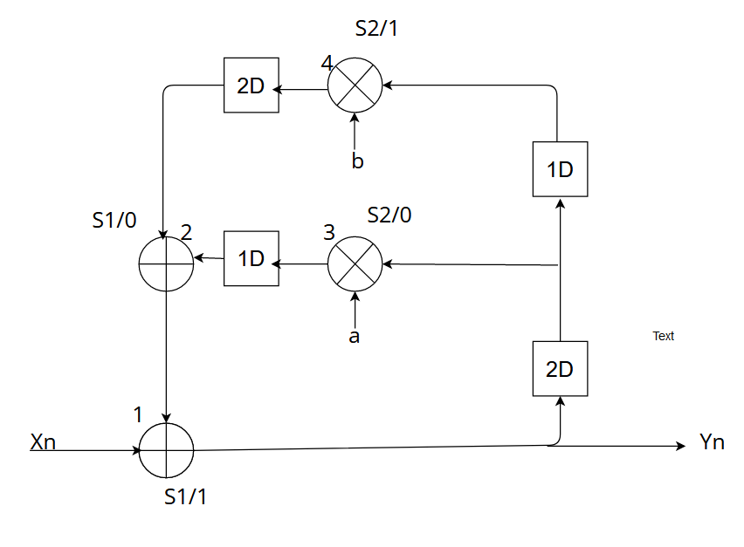
Edges | New Folding equation DF’(U V) = N*Wr(e)+ v – u + Pu
 | DF’=2x2+0-1-1=2
 | DF’=2x3+1-1-1=5
 | DF’=2x1+0-0-2=0
 | DF’=2x2+0-1-2=1
 | DF’=2x0+1-0-1=0
Retimed Version of the graph
1
2D
3
3D
1
4
1D
3
2
2D
4
2
0D
2
1

Slide 7
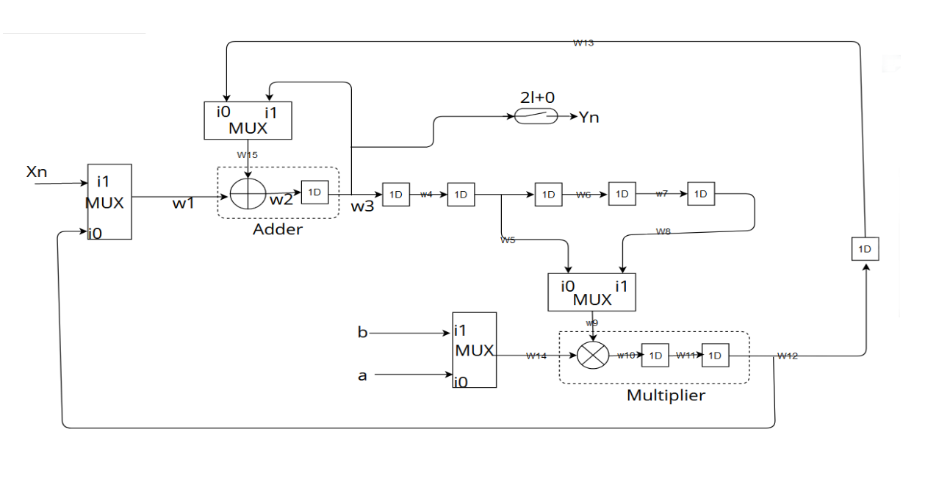
Final 2- Folded Architecture of IIR Filter ; Y[n] = a*Y[n-3] + b*Y[n-5] + X[n]

Slide 8
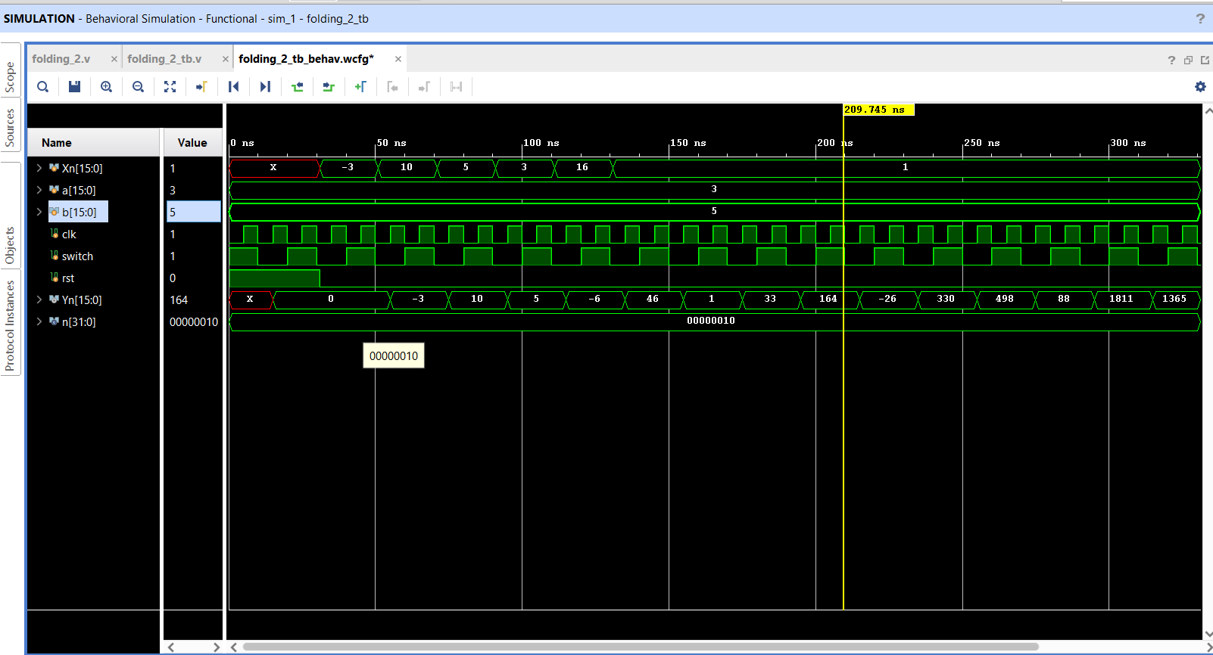
Output waveform of Implemented Verilog code:

Slide 9
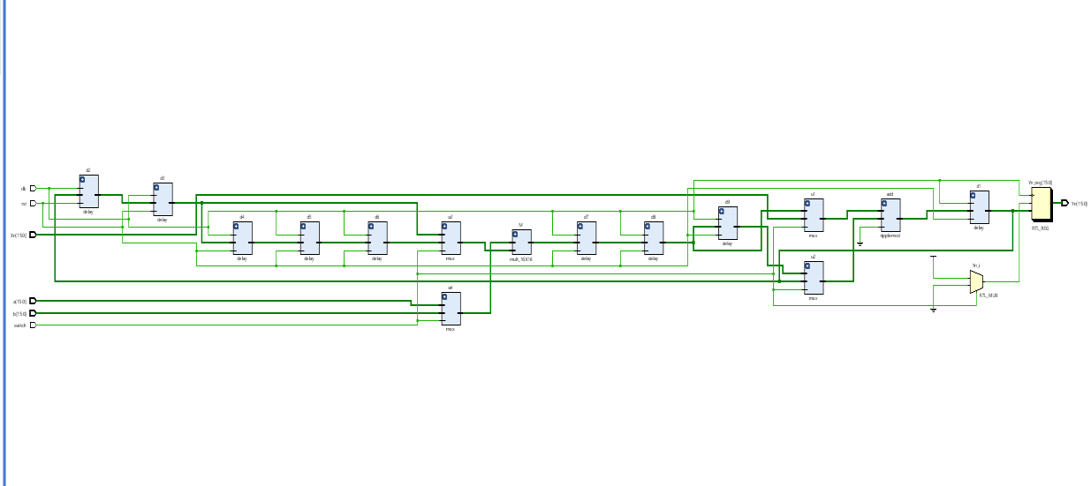
Schematic of module:

Slide 10
Conclusion:
I have successfully implemented 2 folded architecture of IIR filter.
It requires 1 adder , 1multiplier , 4 mux and 9 Delay module to implement this architecture and in simple IIR filter conventional we need 2 adder and 2 multiplier with 5 delay elements.
Area and power requirement of folded is half of the conventional IIR filter which is achieved by reducing functional unit.

Slide 11
References:
1. VLSI digital signal processing systems by Keshab k. Parhi
2. System design through Verilog nptel video by Prof. S. R. Ahamad (IIT Guwahati)
https://www.youtube.com/watch?v=w3jNkZ-5s- U&list=PLwdnzlV3ogoVGq4TIpX4NH6QEFYiAnyvA
3. For making block diagrams : online.visual-paradigm.com

Slide 12
Thank You

